Slide 1

SAP BTP ABAP on Cloud / RAP Training
DAY-2
Anubhav Oberoy
www.AnubhavTrainings.com
Follow excellence with sheer passion

Slide 2


DISCLAIMER
The training content and delivery of this presentation is confidential, and cannot be recorded, or copied and distributed to any third party, without the written consent of Anubhav Trainings

Slide 3

01
ABAP Class
Working with Application logic
02
DB Tables
Create complete DB design for EPM Model and load data
03
CDS Entities
Working with CDS data models with entities and annotations
04
AMDP
ABAP Managed Data procedures
Notes:
https://pixabay.com/photos/san-francisco-transamerica-pyramid-1633203/

Slide 4

CDS – Core Data & Services
CDS is the new approach of building semantically rich data models. It is an extension of SQL in ABAP world.
What has been extended?
DDL – Data definition language – design new data models – new tables, structures
DQL – Data Query Language (CDS Views and CDS Entities) – new views to extract data (agg., join, load, calculate,formulas)
DEL – Data Expression language (expressions like path expression, case expressions)
DCL – Data Control Language (security)
Since in ABAP on Cloud Environment we do not have GUI access (no access to SE11) – we will use CDS
Naming convention – is a best practice to follow in a project. ZCOMPANY_PROJ_OBJTTP_NAME
ZATS_XX_*
We will use an uploader utility provided by SAP, get this in our ABAP on Cloud System to test it
Install the abap git plugin so we can interact with github from our adt tool - http://eclipse.abapgit.org/updatesite/
Download the code from SAP standard repository - https://github.com/SAP-samples/abap-file-uploader
Register a service
Run the utility
www.anubhavtrainings.com

Slide 5














DB Design
Suppose you are working on a company which has recently opt for Rise with SAP and bought a subscription of BTP with ABAP on cloud environment. You do not have an on-premise system, and you have many SAP ABAP consultants in the team. You want to build end to end software in cloud for your customer. We always starts with DB Tables.
www.anubhavtrainings.com

Slide 6
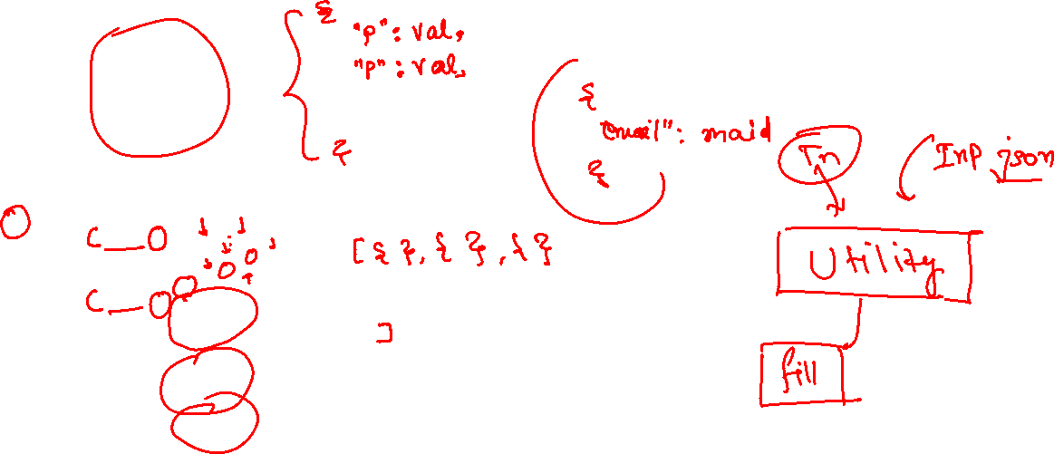
JSON – Java Script Object Notation
It is a light weight data format to transmit data from one system (peer) to another system.
{
“prop”: val,
“prop”: val,
“prop”: val,
“prop”: val,
…
}
{
“empStr”: { “empId”:1001,
“empName”:”Anubhav”,
“salary”: 5000
},
“empTab”: [ {“empId”:1001,
“empName”:”Anubhav”,
“salary”: 5000
} , {“empId”:1001,
“empName”:”Anubhav”,
“salary”: 5000
} , {“empId”:1001,
“empName”:”Anubhav”,
“salary”: 5000
}
]
}
www.anubhavtrainings.com

Slide 7















CDS Views (DQL)
Using the views we can build the Data models which can optimum expose the data out of sap system. The execution of CDS view happens inside the database because when we activate a CDS view, system creates a HANA view. All the logic hence gets executed inside the database. This process is known as code-to-data paradigm.
CDS views are obsolete now, a successor concept was introduced in 2019 called CDS entities.
Application Layer
Database Layer
www.anubhavtrainings.com

Slide 8
CDS entities
CDS entities are advance version of CDS Views. If you know CDS view, you can implement CDS entities very easily
When we activate CDS view, 2 objects gets created. One will be HANA view, and another will be the DDIC view. This DDIC view is of no use. When we CDS entity, No DDIC view gets created.
It save activation time hence the cds entity activation is faster than the cds view activation.
A view have 3 names – file name, cds name and ddic view name. CDS entity is simplified and just have only one name
SAP also improved the runtime engine for entities to make it work faster
CDS entities are strict in nature.
ABAP on Cloud system
SAP does not allow direct access of some of standard database tables available in AOC environment. These objects are called restricted objects. SAP have built the CDS entities on top of these objects, these entities are marked as Released. Which means we can use them in our code.
www.anubhavtrainings.com

Slide 9
VDM – Virtual Data Modeling
It is a best practice/gold standard to build cds entities in SAP system. It is layered approach which provide clear guidance to development teams to create cds views in modular way. It increase the code readability, and reduce the maintenance of the code. All the views are categorised in below categories
Private views – They starts with P_ / Marked with @VDM.private: true / We should never use them in our code as the contract of these views can change release on release.
Interface Views – They starts with I_ / Marked with @VDM.viewType: #BASIC , #COMPOSITE / Highly reusable views and can be used as the contract is stable. In AOC system for example we have I_Currency, I_Country
Consumption Views – They starts with C_ / Marked with @VDM.viewType:#CONSUMPTION / Used for final consumption of data for our use case.
Help Views – They are marked with I_*VH / Purely used for Value helps in Fiori Applications.
Consumption Views
Interface Views
Interface Views
Private Views
Private Views
Interface Views
Interface Views
DB Tables
DB Tables
DB Tables
DB Tables
www.anubhavtrainings.com

Slide 10















Slide 11





























Slide 12
AMDP – ABAP managed Data procedure
Sometimes, the CDS performance is not suitable for our use case and we need more complex technique to process our data deep into database to get best performance using code-to-data paradigm
We want to use database specific features
CDS views have limitations
CDS views cannot be debugged
Overcome the disadvantages of CDS where we need to branch output of one Queries to another
We cannot write imperative logic using CDS – IF, ELSE, LOOP, WHITE, EXCEPTION etc.
CDS also does a strict type check while writing joins and associations
An AMDP is:
A static function in ABAP class marked with marker interface IF_AMDP_MARKER_HDB
The function can only have Import and Export parameters and all parameters must be passed by value
We cannot use complex data types (deep)
Any DB table which we plan to use with AMDP should be added to using clause
When we run the AMDP, A procedure gets created inside the DB
All the code will be written in SQL scripting programming language which will be pushed into the database
Since we directly execute AMDP in DB, there is no automatic client handling
www.anubhavtrainings.com

Slide 13
SQL Scripting
SQL Script is a programming language used inside databases, which is an advance version of plain SQL. It is the last option to improve performance of our applications and achieve code to data paradigm by code-push-down.
Why SQL Script
In the past we used to Fetch the data in ABAP, Loop over the data, Process the data and then write data back to database. We want to fully leverage the computational powers of SAP HANA, hence using SQL script we can achieve it. All our data intensive logic which we write using ABAP can now be pushed down to HANA DB using SQL Script.
https://help.sap.com/docs/SAP_HANA_PLATFORM?locale=en-US&task=use_task
SQL Script is not case-sensitive and every line ends with semi-colon (;)
We can use the code constructs like IF, ELSE, LOOP, FOR, WHILE, RAISE
When we create variables, they are assigned with null value
The = is comparison operator and := is the assignment operator. We can assign the value to variable using the var = val but when we use the variable in the code, we use value of (:) operator to use a variable.
When we assign the a query to a variable, the variable will allocate memory automatically
www.anubhavtrainings.com

Slide 14
CDS Table function
Bridge the gap between CDS and AMDP, A CDS table function
Defines the skeleton of the data which we want from DB
When it executes, it actually calls SQL Script code
It creates a FUNCTION database unlike AMDP creates a PROCEDURE in database
The CDS table function, can later be used to build view on view or can be used in OTHER CDS views also as JOIN/Agg
Plain CDS functions:
https://help.sap.com/doc/abapdocu_752_index_htm/7.52/en-US/abencds_f1_builtin_functions.htm
www.anubhavtrainings.com

Slide 15




Challenges in ABAP development
UI
Common needs
Create application logic
Insert, update, delete, validate, select data
Perform validations
Check customizing
Handle locks
Create A/c documents
Manage Documents
Application Code
I, U, D, S, V
Search Documents
Validate before save
Alex, ABAP Developer,
SAP FICO
UI
Challenges
Thinks differently
Adapt application code
High maintenance
No standardization
Different coding practices
Lack of standard
Create Sales Orders
Manage Sales Orders
Application Code
I, U, D, S, V
Search/Filter Sales Order
Compute Sales total
Stella, ABAP Developer,
SAP SD
www.anubhavtrainings.com

Slide 16
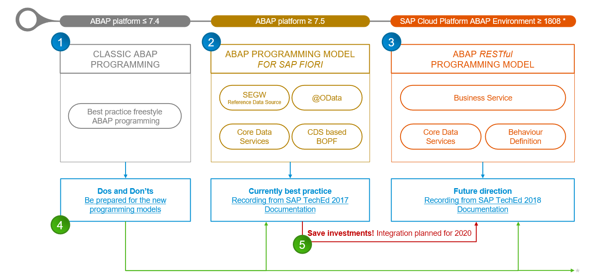
Evolution of ABAP Programming Model
www.anubhavtrainings.com

Slide 17
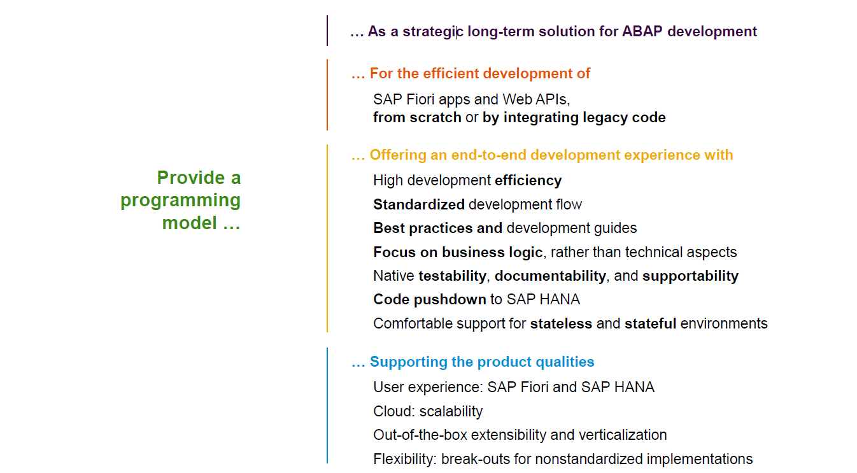
Restful ABAP Programming
www.anubhavtrainings.com

Slide 18
Restful ABAP Programming
The ABAP RAP (Restful Application Programming) Model defines the architecture for efficient application development for HANA optimized ABAP applications. It supports development of
Greenfield applications – A completely new application from scratch
Brownfield applications – A new/extension of application using OLD code
It is based on proven technologies and frameworks such as CDS entities to define semantically rich data model and service model infrastructure for creating and binding OData services for different use cases e.g. Fiori App, WebAPI, InA
www.anubhavtrainings.com

Slide 19
www.anubhavtrainings.com
Thank You
End of Day 2
www.anubhavtrainings.com

Slide 20


We’re committed to empower you to be
#FutureReady
through powerful training solutions.
We build the workforce of the future.
250+
Corporate Clients
30,000+
Learners Trained
25000+
Learners Placed
FREE WEBINARS
Sign up for free webinars with industry experts every fortnight!
Enroll Now!
Contact us today!
https://anubhavtrainings.com

